Slide 1
8/5/25

Slide 2
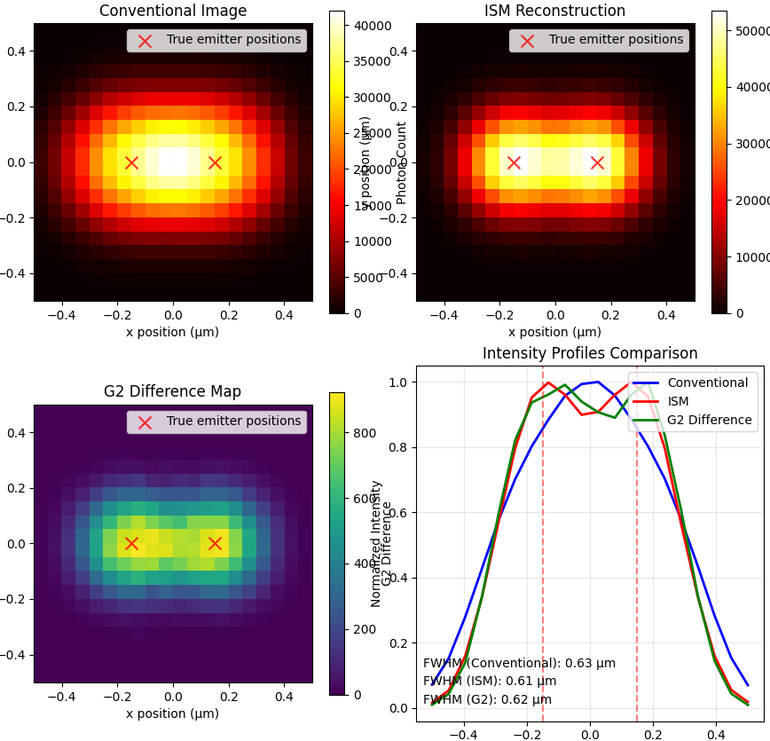
Comparison PSF I_confocal, I_ISM, G_d

Slide 3
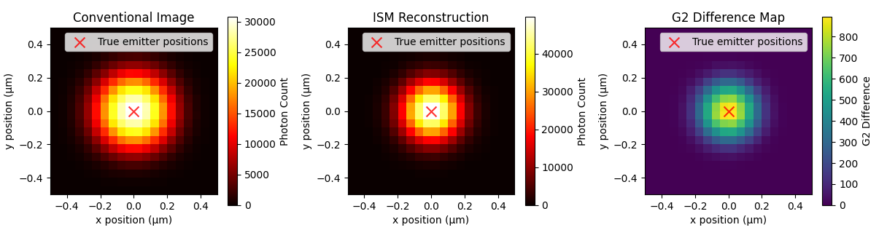

Slide 4
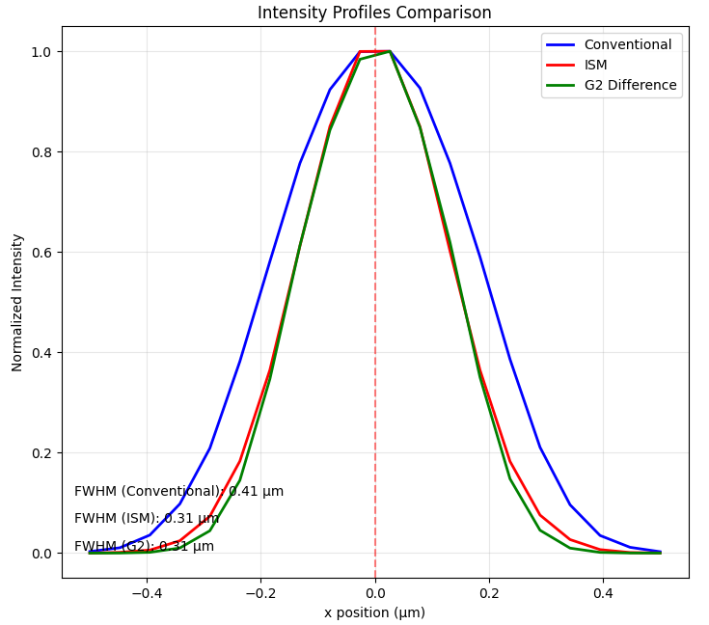

Slide 5
Fixed issue that caused very high g2(0)/G2(0) at places that had contributions from emitters at the same distance from 2+ emitters

Slide 6
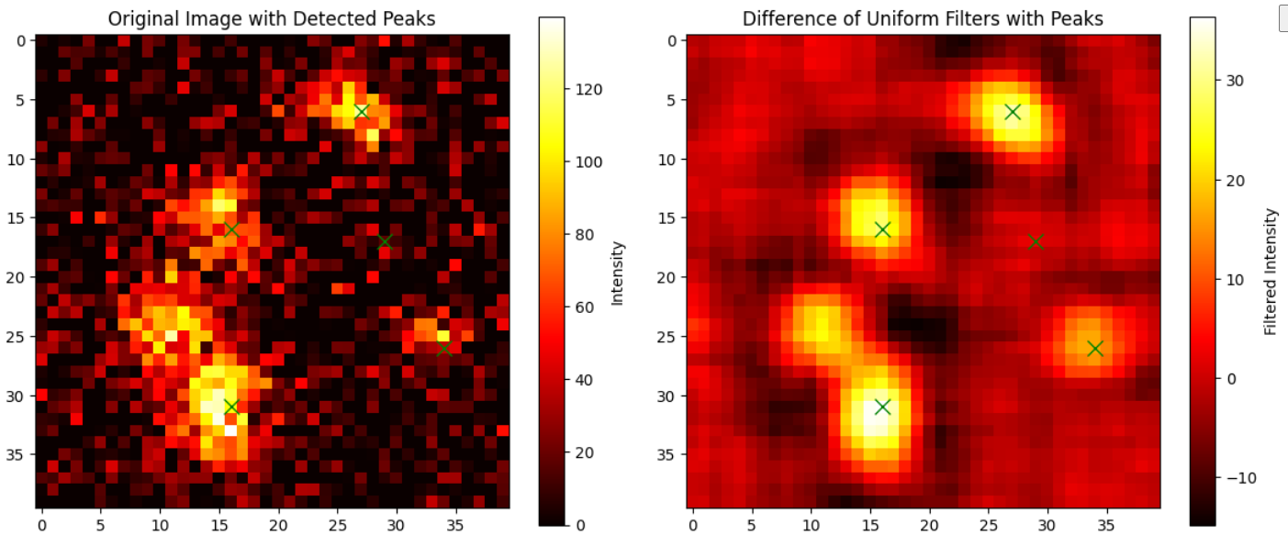
Uniform filter

Slide 7
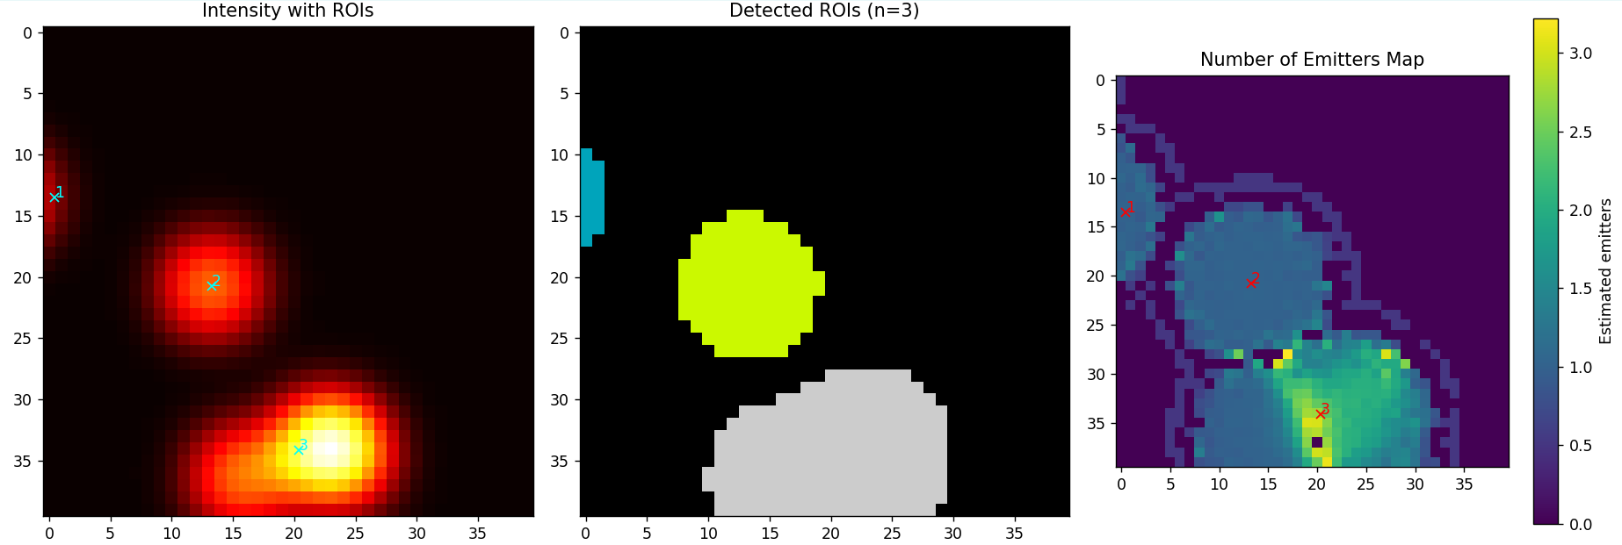

Slide 8
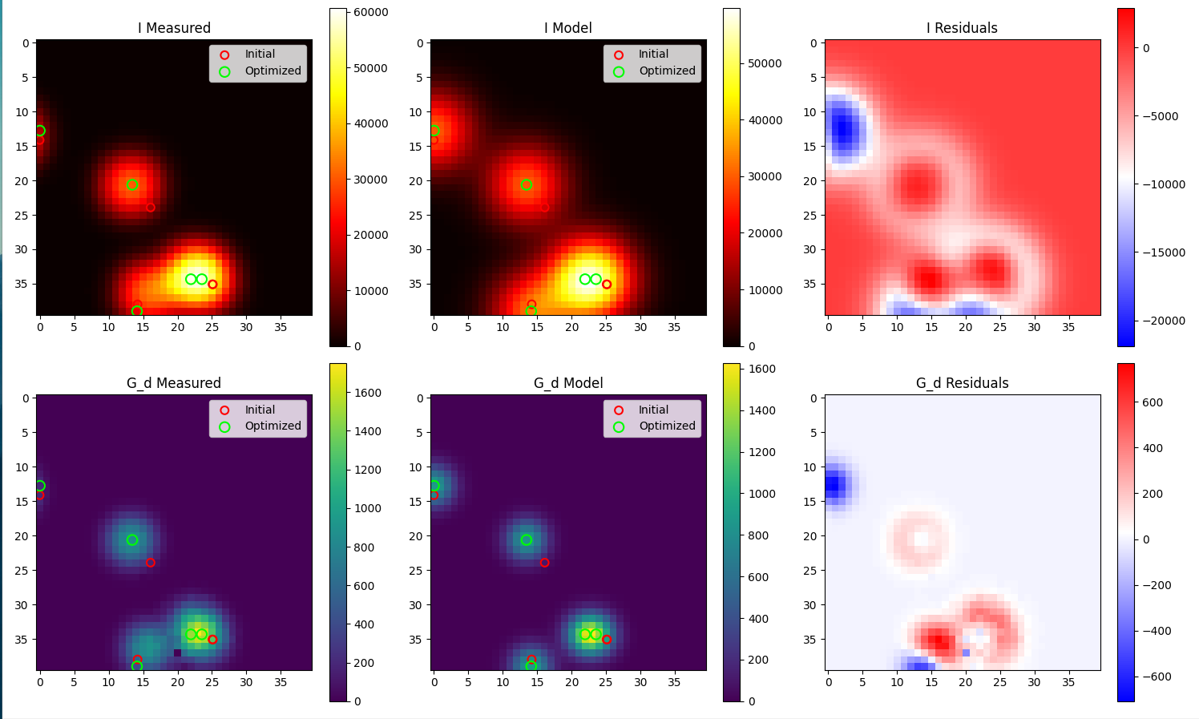

Slide 9
Algorithm
Test: 5 emitters / um^2

Slide 10
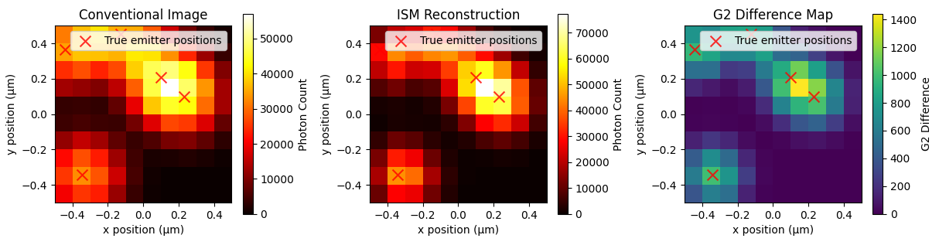
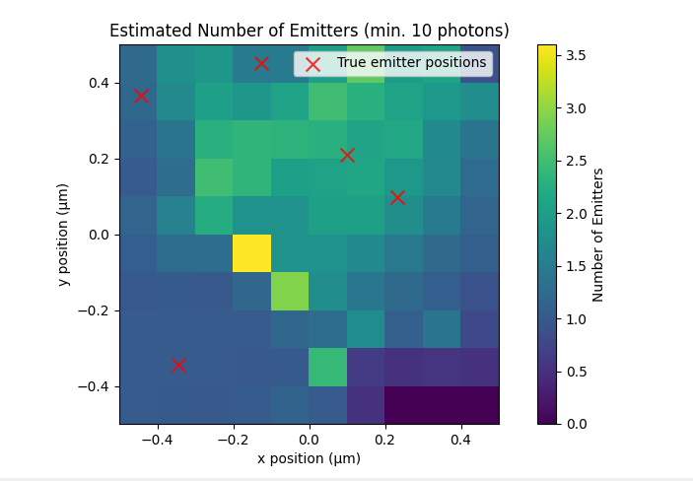

Slide 11
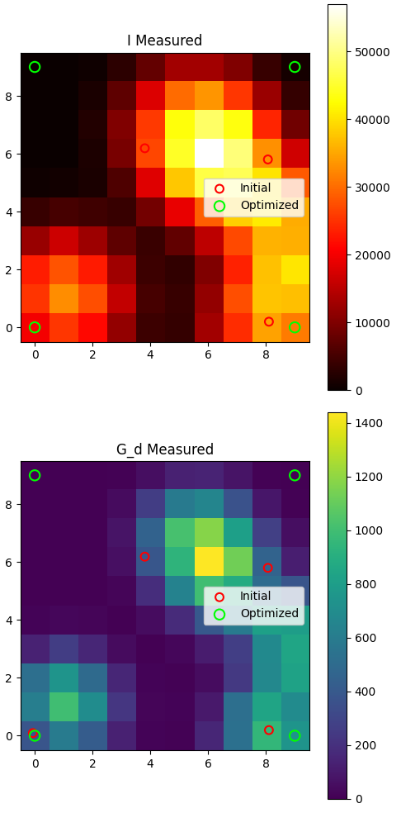
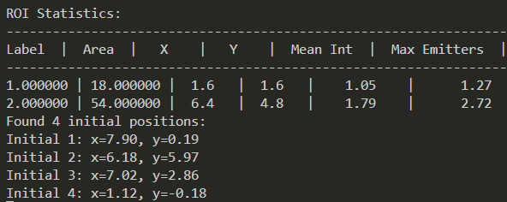
Problem: even an error of 1 emitter messes
up the reconstruction completely.
Solution: vary estimated number of emitters per
ROI with 1 or 2.
^ One too few messes up the optimization

Slide 12
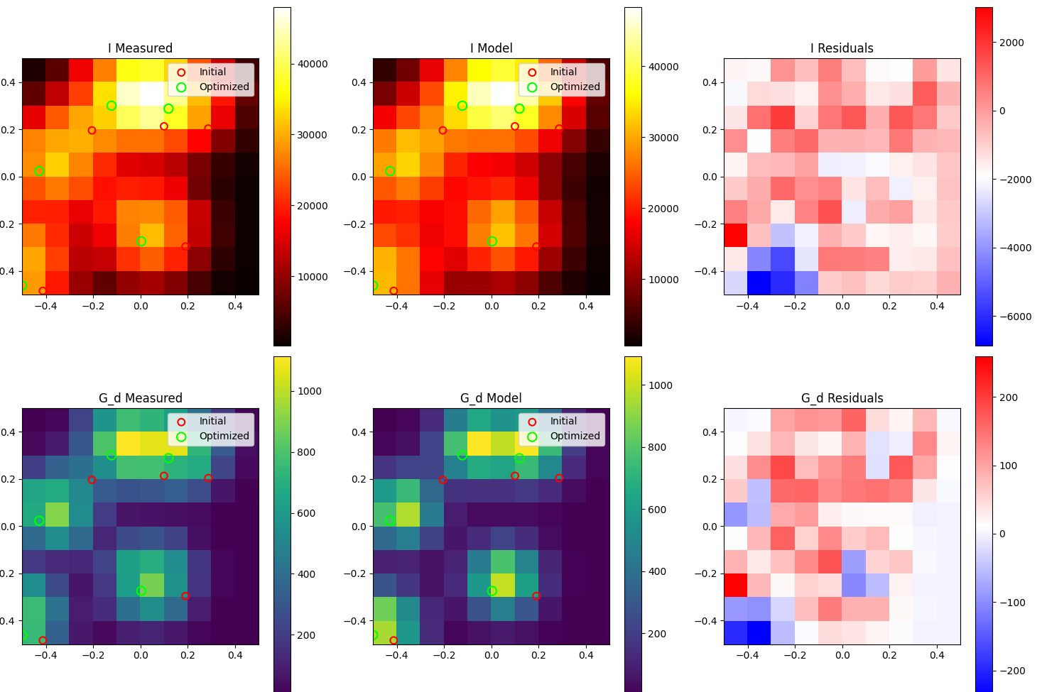
But: 1 more gives very good reconstruction.

Slide 14
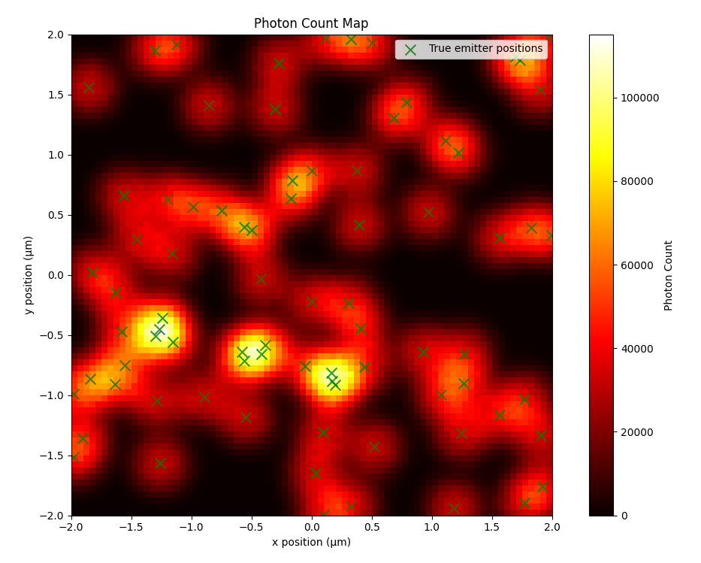
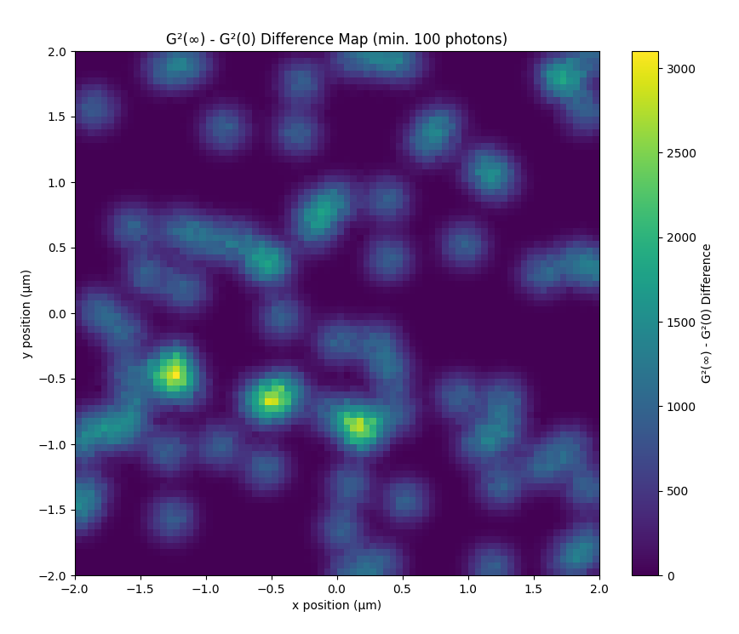
Larger field of view?

Slide 15
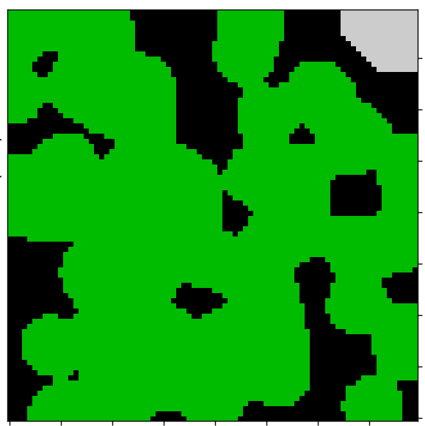
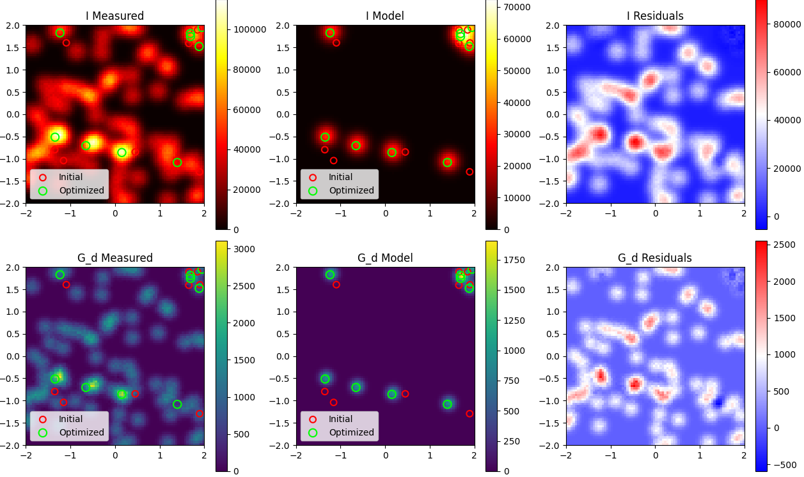
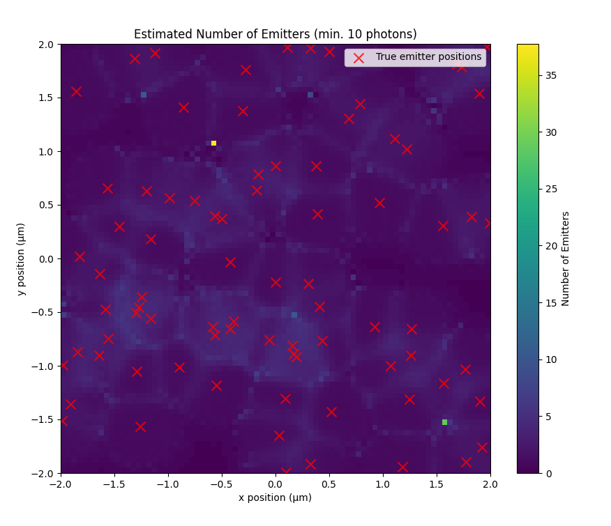
Problem: too large ROI => underestimation of n

Slide 16
Todo
Add noise to test images
How to benchmark better?
Make smaller ROI’s for large field of views? (more than 1x1 um)

